Slide 1
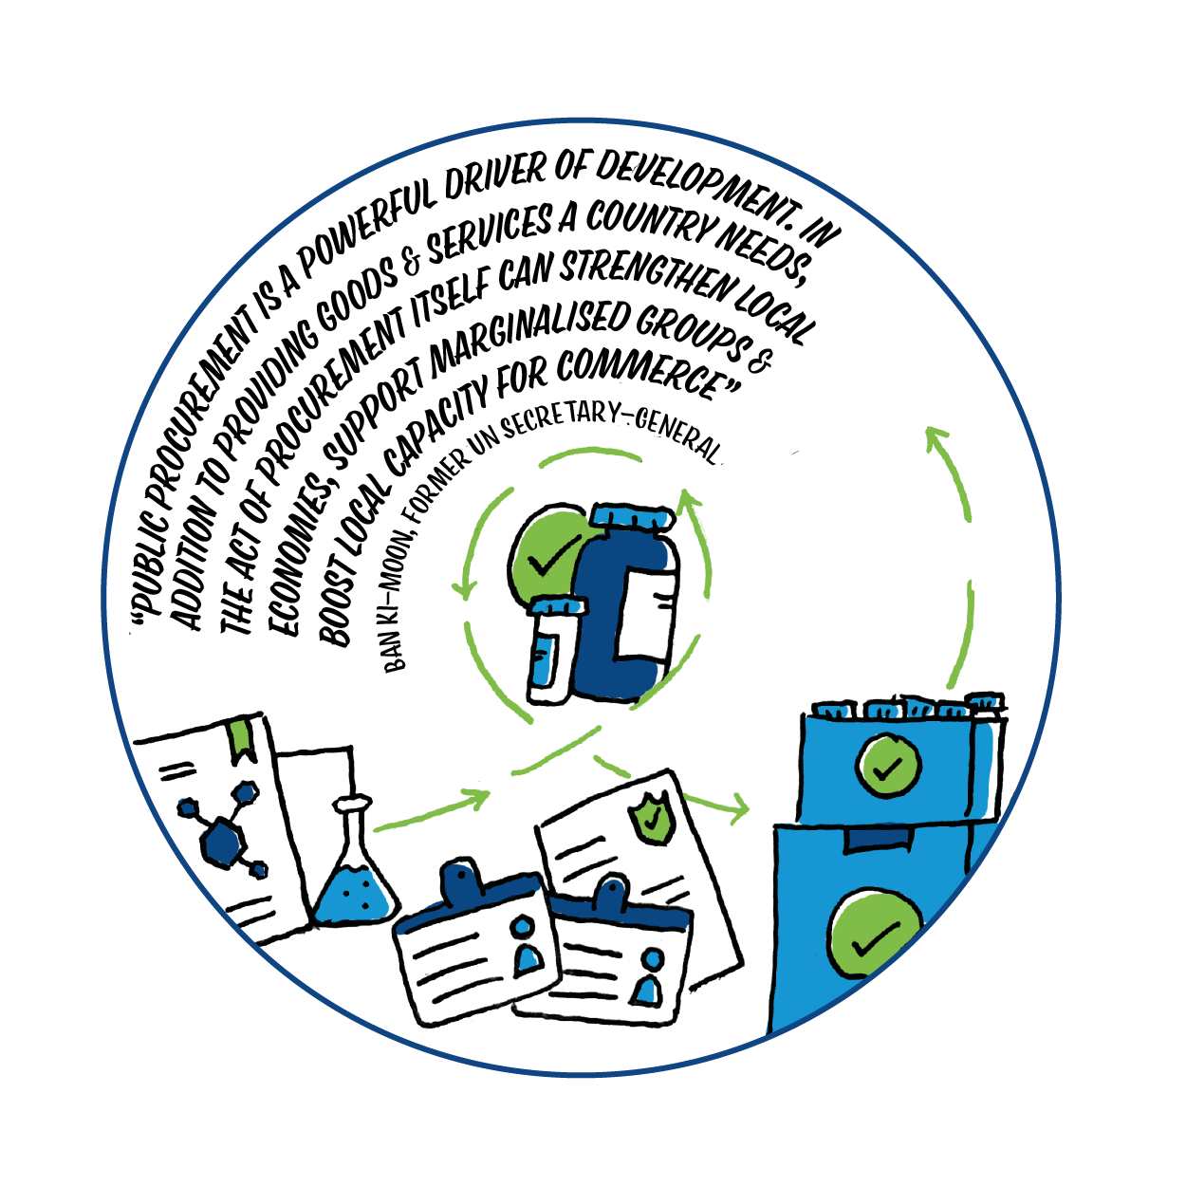





Home and away
Poverty, inequality and health
Notes:
These activities connect to SDG 1: No Poverty and SDG 10: Reduced inequalities. They can be used in conjunction with the SDG flash cards and will act as a stimulus for exploring some of the reflection questions on the cards. The flash cards can be found here https://www.scottishglobalhealth.org/wp-content/uploads/2021/07/SDG_NHS_Cards_DIGITAL-2nd-2.pdf

Slide 2


What is in the workshop
Overview of SDG 1: No poverty and SDG 10: Reduced inequalities
Starter 1: Gapminder quiz
Starter 2: If the world were a village of 100 people
Activity 1: The Development Compass Rose
Activity 2: The issues tree
Activity 3: Health inequalities
Think, act, reflect

Slide 3

SDG 1: No poverty
End poverty in all its forms everywhere
Poverty is a driver of health inequality. The daily experience of poverty is about access to resources, and the ability to plan and have control over basic needs. It is about justice and dignity.
There are enough resources in the world to ensure everyone’s basic needs are met. Eradicating poverty is about the systems at global and national levels that perpetuate inequality and access to resources, and the recognition that our individual choices within these systems can impact on others.
Notes:
Introduce the participants to SDG 1. More information and the targets for the SDG 1 can be found here https://www.globalgoals.org/1-no-poverty

Slide 4

SDG 1: No poverty
In what ways do you see people in Scotland experiencing poverty?
When you think about poverty in Scotland and poverty in other countries do you reflections differ? If so why?
Notes:
These are the ‘big’ questions around SDG 1 which these activities will stimulate discussion around.

Slide 5
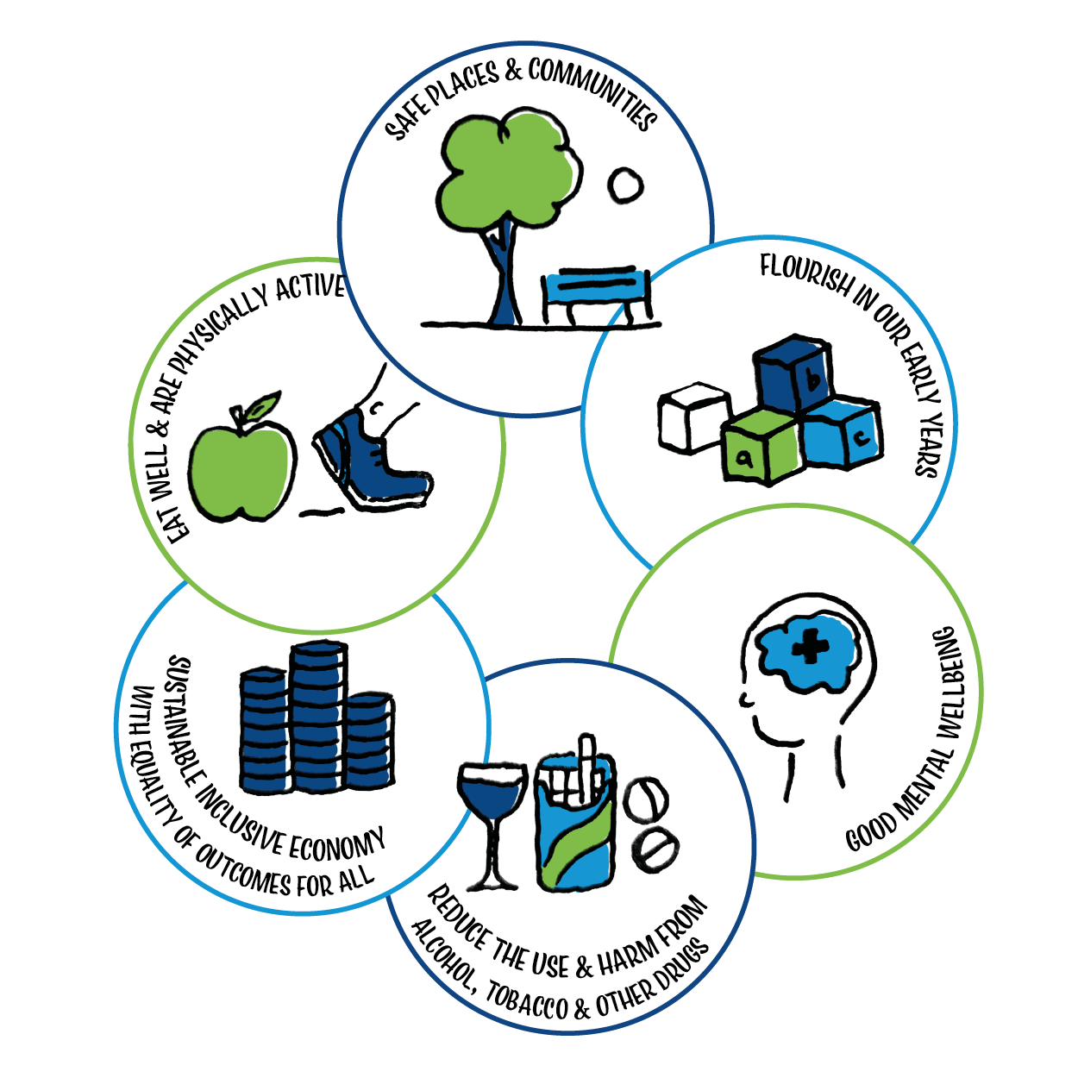
SDG 10: Reduced inequalities
Reduce inequality within and among countries
Inequality exists on local, national and international levels and is impacted by factors that are historical, geographical, economic, political and social.
On an individual level, a small group of people control a huge proportion of the world’s wealth. Inequality is about access to and control over resources, as well as opportunity and participation in decision-making at many levels. Inequality persists due to unjust systems and power structures that benefit only the few.
Notes:
Introduce SDG 10: Reduced inequalities. More information and the targets for SDG 10 can be found here https://www.globalgoals.org/10-reduced-inequalities

Slide 6

SDG 10: Reduced inequalities
What are the drivers of health inequalities in Scotland?
How does health and wellbeing in Scotland differ from other countries? What causes the difference?
What do you think about the word ‘reduced ’ in this SDG? Does this suggest that inequality should be an accepted part of how we live?
Notes:
These are some of the ‘big’ reflection questions around SDG 10 which these activities will stimulate discussion around.

Slide 7

Starter 1: Gapminder Quiz
Aims
To challenge misconceptions about ‘facts’ around poverty and inequality
To challenge ourselves around what we ‘know’ or think we ‘know’
Notes:
There are many misconceptions about ‘facts’ around poverty, inequality and other global issues. This tool from Gapminder dispels some of these misconceptions. There is a tendency to see the world negatively when in fact there have been big improvements in many areas of poverty and health over the last 40 years. It does also highlight that COVID is reversing some of this.

Slide 8


Starter 1: Gapminder quiz
How much do you really know about poverty and inequality?
Take a quiz and find out
Notes:
There are shorts quizzes for SDG 1: No poverty and SDG 3: Health and Wellbeing – they also have really useful information after each questions. This could be done as a group or you could get people to do the quiz individually on their phones. Discuss with the group what surprised them or challenged them about he quiz.

Slide 9


Starter 2: If the world were a village….
We are approaching 8 billion people living on the planet. Where do they live? How old are they? Who has access to healthcare and clean water? Who is literate?
Watch this video
Notes:
This 3.35 minute film clip asks what the world would look like if it were a village of 100 people. Simple statistics provide a snapshot of where people live, what language they speak and who has access to what be it healthcare, clean water, the internet or an education.

Slide 10
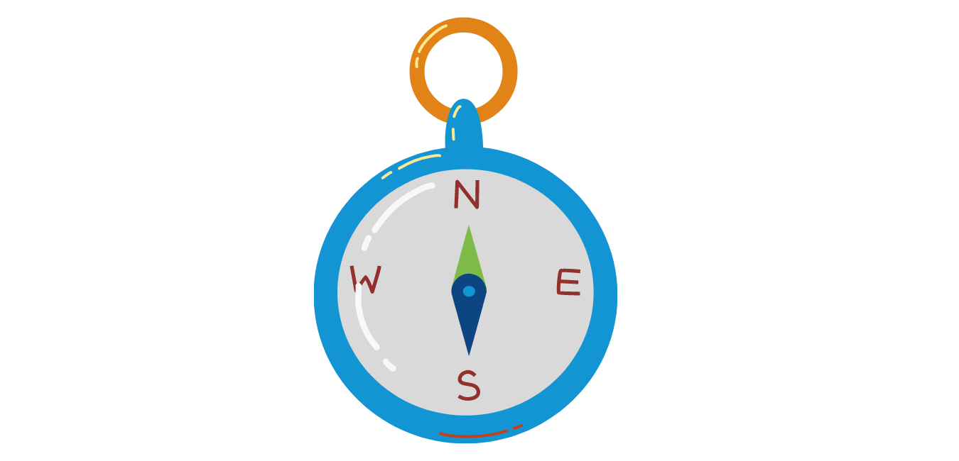
Activity 1: The Development Compass Rose
Aims
To stimulate discussion thinking around an issue from many perspectives
To reflect on the causes and impact of poverty and inequality both in Scotland and a country in the Global South
Notes:
This activity aims to draw out deeper thinking around poverty and its causes both in Scotland and the Global South.
Participants interrogate selected images and ask questions about it – in this case a local picture and a global image are provided which connect to poverty and inequality. The activity works best in a face to face workshop. However, you could also run the activity using a jamboard if delivering online.
This activity For a more detailed description of the activity and a template please visit http://www.stridemagazine.org.uk/activities/spring-summer-2015/item/73-the-development-compass-rose-a-framework-for-raising-questions

Slide 11
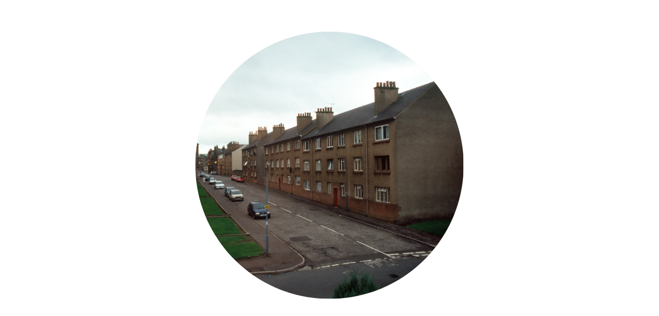
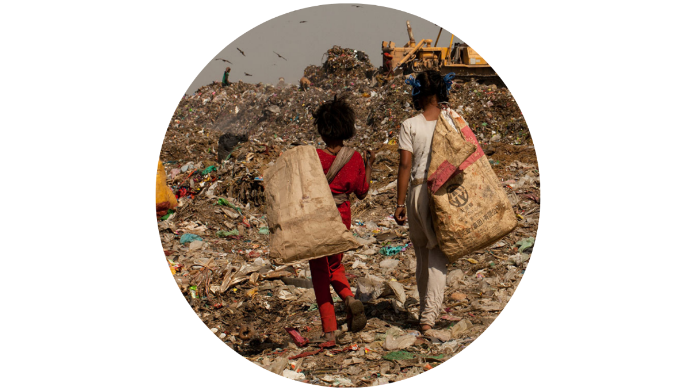
Activity 1: The development compass rose
Notes:
Provide participants with a stimulus image around the topic for discussion. You might choose an image from Scotland or the Global South. You may want to use to images and compare the questions which are generated to see how similar or different the responses are. There are some sample images on the next slide.

Slide 12
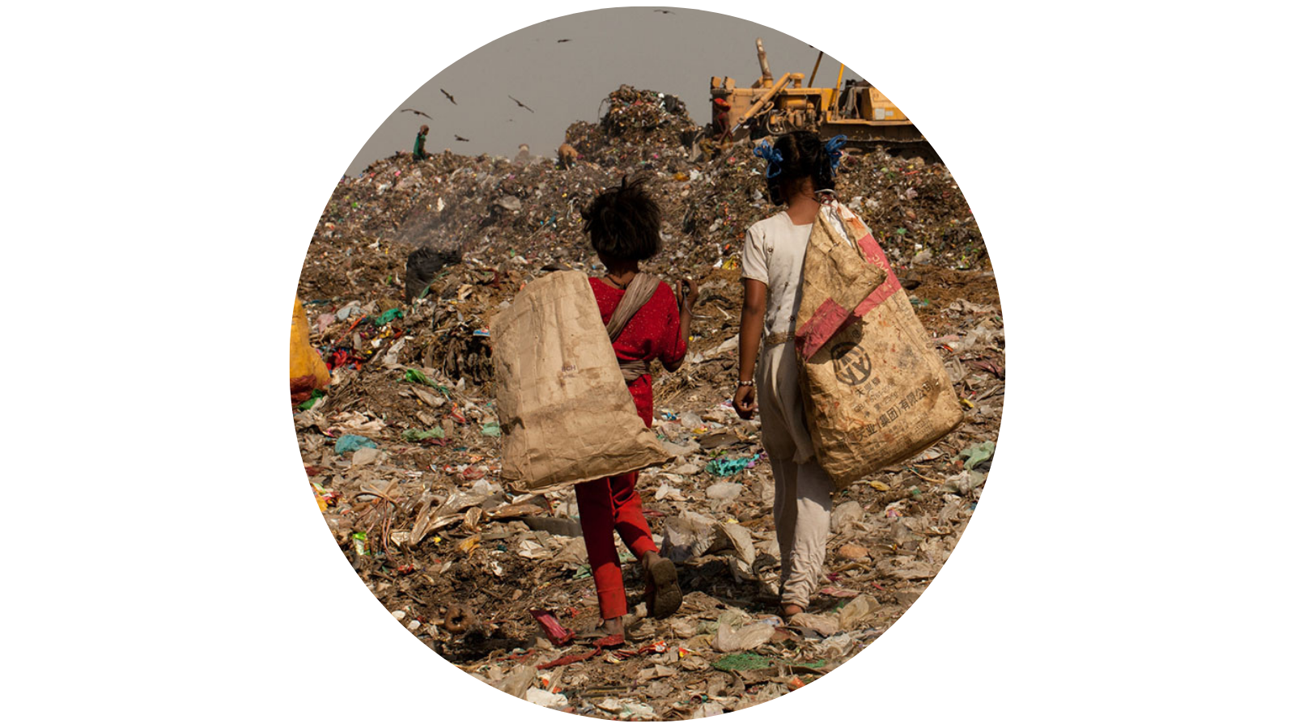
Activity 1: The development compass rose
Notes:
Ask participants to interrogate the image(s) and ask questions based on what is going on in the photo. Each question needs to be written on to a post-it note. Use virtual post-its on jamboard if delivering online.

Slide 13
Questions around the natural environment
Questions around economics / trade / aid
Questions around power,
governance and influence
Questions around gender / sexuality /
race / class etc.
Notes:
Participants need to categorise their questions using the 4 points of the compass. North = Qs around the natural environment, East = Qs around economics / trade / aid, South = Qs around gender / sexuality / race / class etc, West = Qs around power, governance and influence.
Once they have sorted the questions review where they are – frequently there are a lack of questions in some areas – usually power and economics. Participants then ask more questions which help them interrogate the issue further.

Slide 14
Activity 1: Development compass rose
What did the questions reveal for you about poverty in Scotland and in other countries?
When you think about poverty in Scotland and poverty in other countries do you reflections differ? If so why?
What are some of the structural inequalities which keep people in poverty both in Scotland and the wider world?
Notes:
Use these discussion questions to debrief the activity.

Slide 15
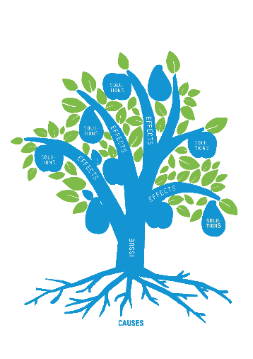

Activity 2: The issues tree
Aims
To explore and connect the causes and impacts of poverty and inequality in Scotland and / or in other countries
To find creative actions to affect positive change around poverty and inequality in Scotland and / or in other countries
Notes:
The issues tree is a tool for exploring an issue – links causes and impacts and provides a creative space to think about possible actions / solutions as part of the causal chain. This can be used for exploring any issue – the example here is for poverty. You can decided the parameters for this – Scotland / Global South etc.

Slide 16
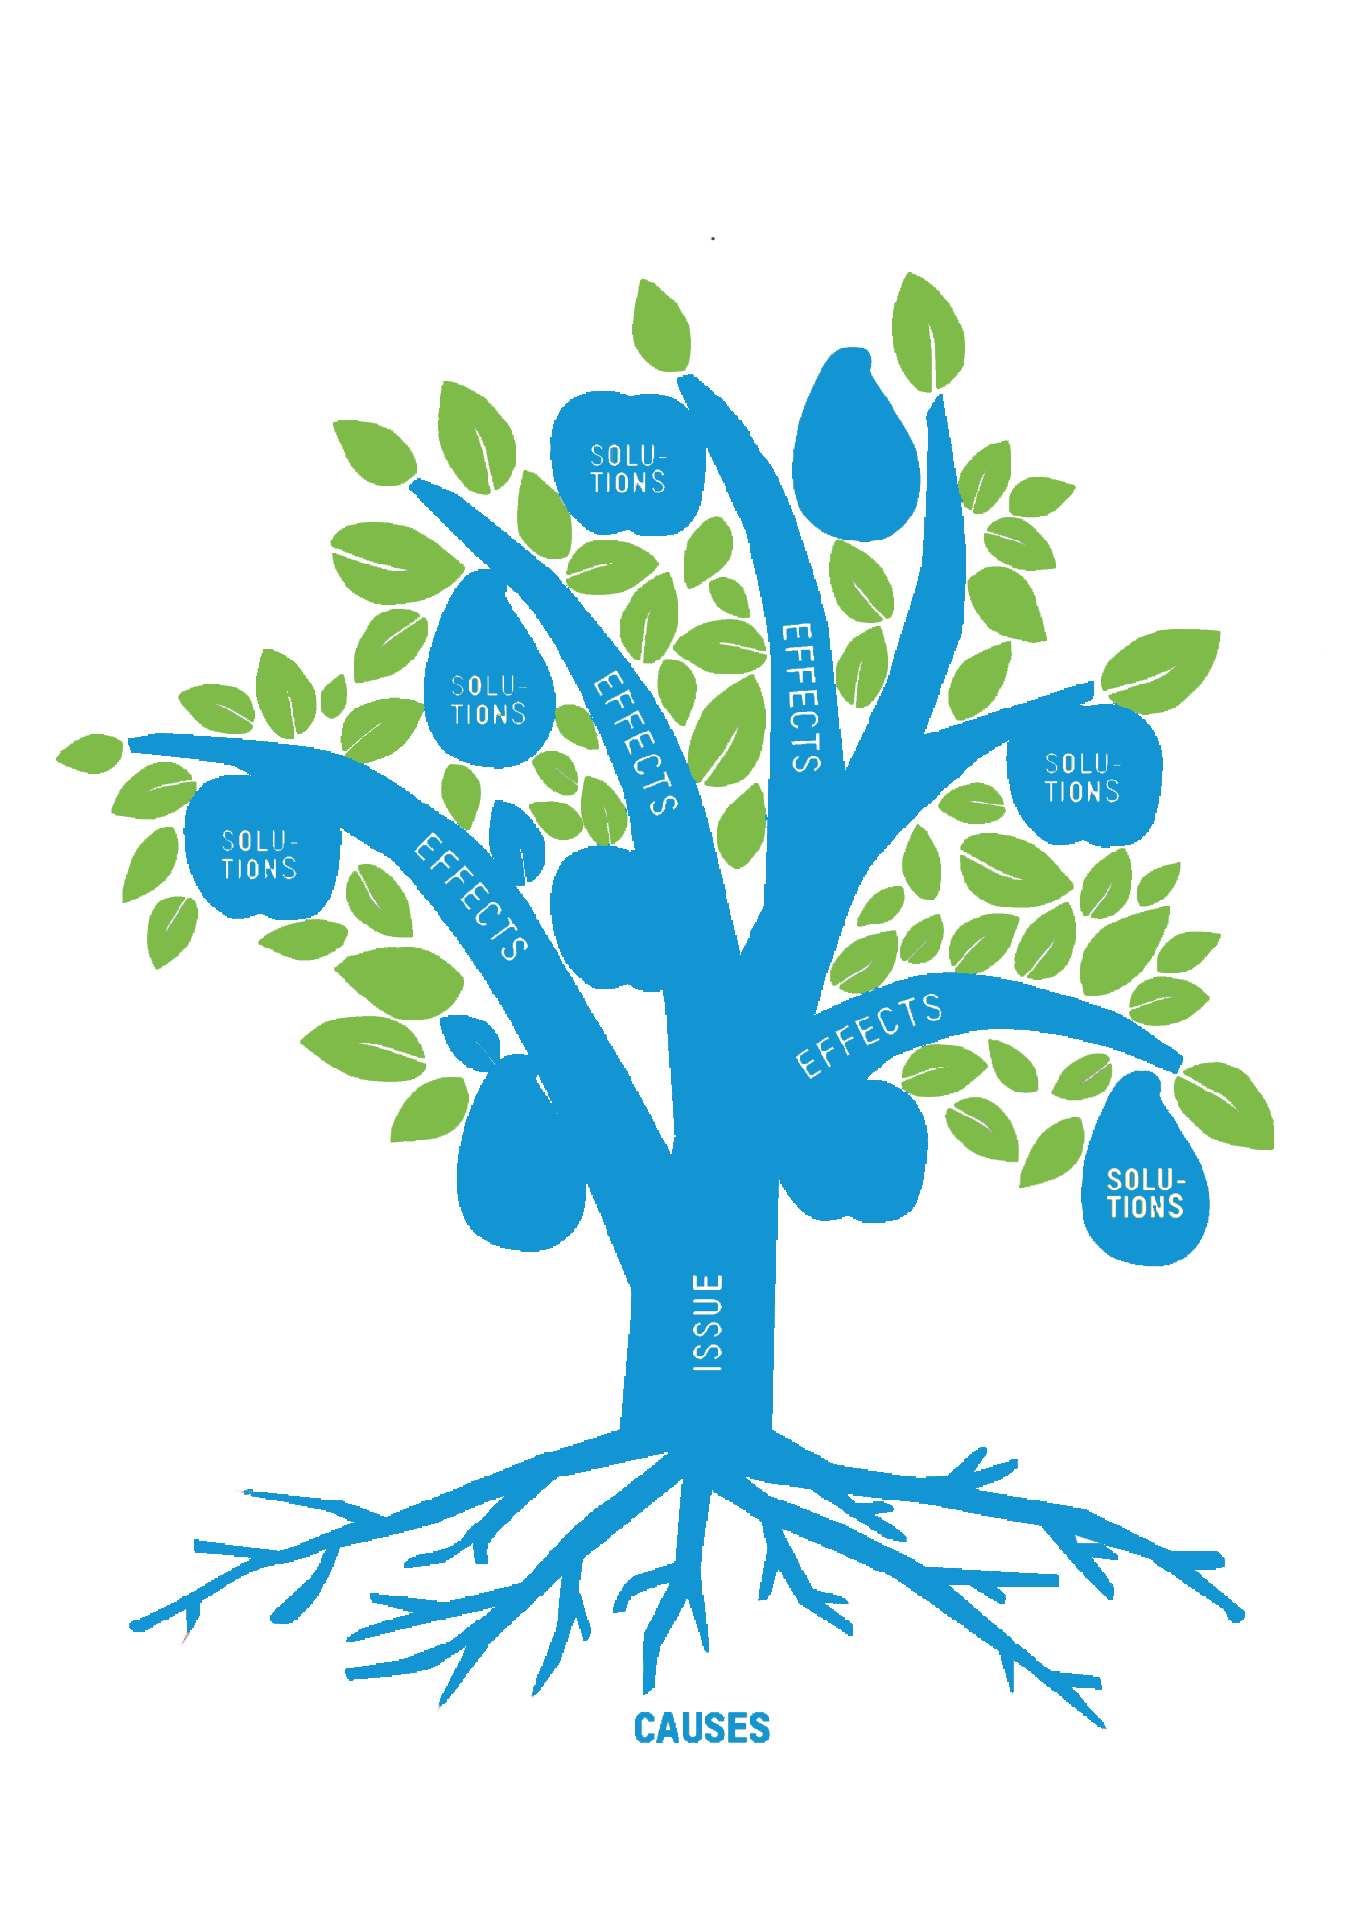
Activity 2: The issues tree
Notes:
The issues tree can be run as a group activity using flip chart paper and pens if F2F or using a jamboard if you are running a virtual session. Ideally you could go into break out groups and one group look at poverty in Scotland and one group look at poverty in a country in the Global South. Label the issues tree using the instructions below.
Trunk – list the words associated with poverty in Scotland / country in the global south
Roots – What are the root causes of poverty? Write each one in the root.
Branches – For each ‘root problem’ what is the corresponding effect or consequence. Write the effects to the branches.

Slide 17
Activity 2: The issues tree
What needs to happen to get from root problem to solution?
What role can you play?
What role can the NHS play?
Notes:
Use these discussion questions with the group to reflect on what actions can be taken individually and by the NHS to create change – this might be focussed on Scotland, the Global South or both. Once you have had the discussion, revisit the issue tree and add the actions to the leaves of the tree.

Slide 18
Activity 3: Health inequalities
Aims
To reflect on understanding around the causes of health inequalities
To consider the role NHS practitioners can play in challenging understanding and practise around health inequalities

Slide 19
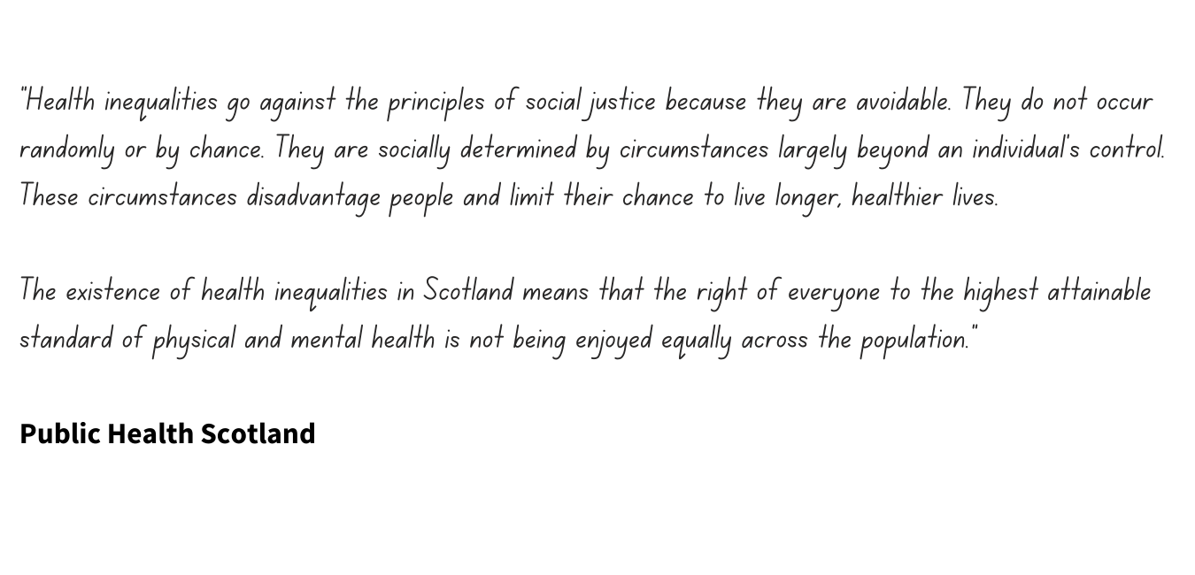

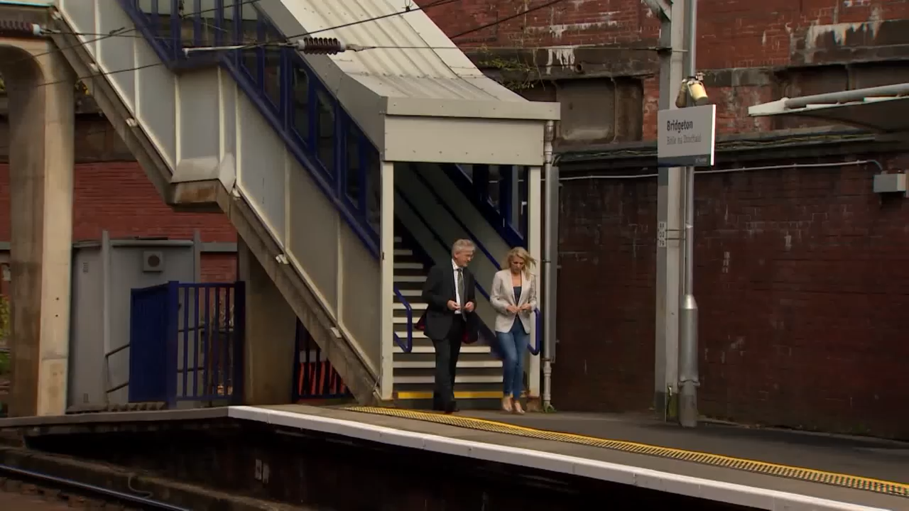
Activity 3: Health inequalities
Source: Spotlight on life expectancy and tackling health divide | ITN & Health Scotland video
Notes:
Use this quote and the following video clip as an initial stimulus for the discussion questions on the next slide.
Link to video in presentation: http://www.healthscotland.scot/health-inequalities/what-are-health-inequalities#:~:text=Health%20inequalities%20go%20against%20the,to%20live%20longer%2C%20healthier%20lives.

Slide 20
Activity 3: Health inequalities
What is your response to the quote / film clip?
What do you think about the word ‘reduced’ in SDG 10 : Reduced inequalities? Does this suggest that inequality should be an accepted part of how we live?
What role do you feel the NHS has to play in reducing health inequalities in Scotland?

Slide 21



Think
Act
Reflect
Notes:
These following slides can be used flexibly. They provide an opportunity to explore the issues further, to consider what positive actions for change participants can take and reflect on what the group has looked at through out the workshop.

Slide 22

Think - listen
TED talk
Those living in poverty are not a failure, the system is failing. In the USA, over a trillion dollars is spent on poverty alleviation each year, yet the poverty rate here is far higher. As the president & CEO of a non-profit, Teva Sienicki has experienced first-hand the devastating, cyclical nature of intergenerational poverty. In this inspiring talk, she argues that in order to end poverty once and for all, we need to treat the root causes of the problem, such as ensuring a living wage for all not just the symptoms.
Watch the video
Notes:
The ‘think’ slides share links to TED talks and articles which can stimulate further discussion around specific poverty related issues.

Slide 23
Think - listen
TED talk
Physician Cheryl Holder states that “for the poor and vulnerable, the health impacts of climate change are already here”. Unseasonably hot temperatures, disease-carrying mosquitoes and climate gentrification threaten those with existing health conditions, while wealthier people move to higher ground. In an impassioned talk, Holder calls on doctors, politicians and others to build a care system that incorporates economic and social justice.
Watch the video

Slide 24

Think - read
Vaccine inequality
One in five children in rich countries lives in relative poverty. And one in eight risks going hungry or not getting the right food . This UNICEF report ranked 41 of the world’s wealthiest countries on how well prepared they are to meet the UN’s Sustainable Development Goals most relevant to child well-being.
Read the article
The World Health Organization (WHO) has criticised what it describes as a "shocking imbalance" in the distribution of coronavirus vaccines between rich and poor countries.

Slide 25

The Health Literacy place – useful source of health literacy information and resources in Scotland
Think - explore
The Joseph Rowntree Foundation – social change organisation working to solve poverty in the UK
Glasgow Centre for Population Health – informing and supporting action to improve health and tackle inequality
The Health Literacy Place – useful source of health literacy information and resources in Scotland
Notes:
The following websites are useful to share with participants

Slide 26
Act
Get informed – Engage with articles, blogs, videos and campaigns
Be Political – Write to your local MP or MSP
Educate – Host a workshop, talk or discussion about issues
covered in this workshop with your colleagues
Challenge – Use the reflection questions on the next slide
Notes:
Some ideas to encourage participants to get started. You might also want to (re) visit some of the activities from the introductory workshop which has more action ideas.

Slide 27
Reflect
Am I aware of the stresses that my patients might be under? Am I aware of ‘hidden’ costs to attending appointments? E.g. travel or taking unpaid time off work
Do I make assumptions around wealth and education which impact on how I talk to patients? Have I considered age, culture and language in my interactions?
Do I explain things clearly to all patients in language they can understand?
Do they have time to process it? Do they feel able to ask questions?
Notes:
A personal reflection activity. Many of these connect to Health Literacy and more ideas, tools and techniques can be found here http://www.healthliteracyplace.org.uk/

Slide 28
Reflect
Something which made you think
Something you are curious about and what to find out more
Something you will do after this session
Notes:
This is an activity to draw the workshop to an end. The workshop materials can be used flexibly and this reflection activity can be used at the end of a session after using any of these materials.
Ask participants to think and share in pairs the points on the slide. If you want to hear all the voices in the room at the end – ask participants to share one of the points with the group.

Slide 29



Thank you for your time
www.scotdec.org.uk
www.scottishglobalhealth.org
@scotdeclearning
@scottishGHCU
The contents of this document are the sole responsibility of the 15 project partners and can in no way be taken to reflect the views of the European Union.

