Slide 1
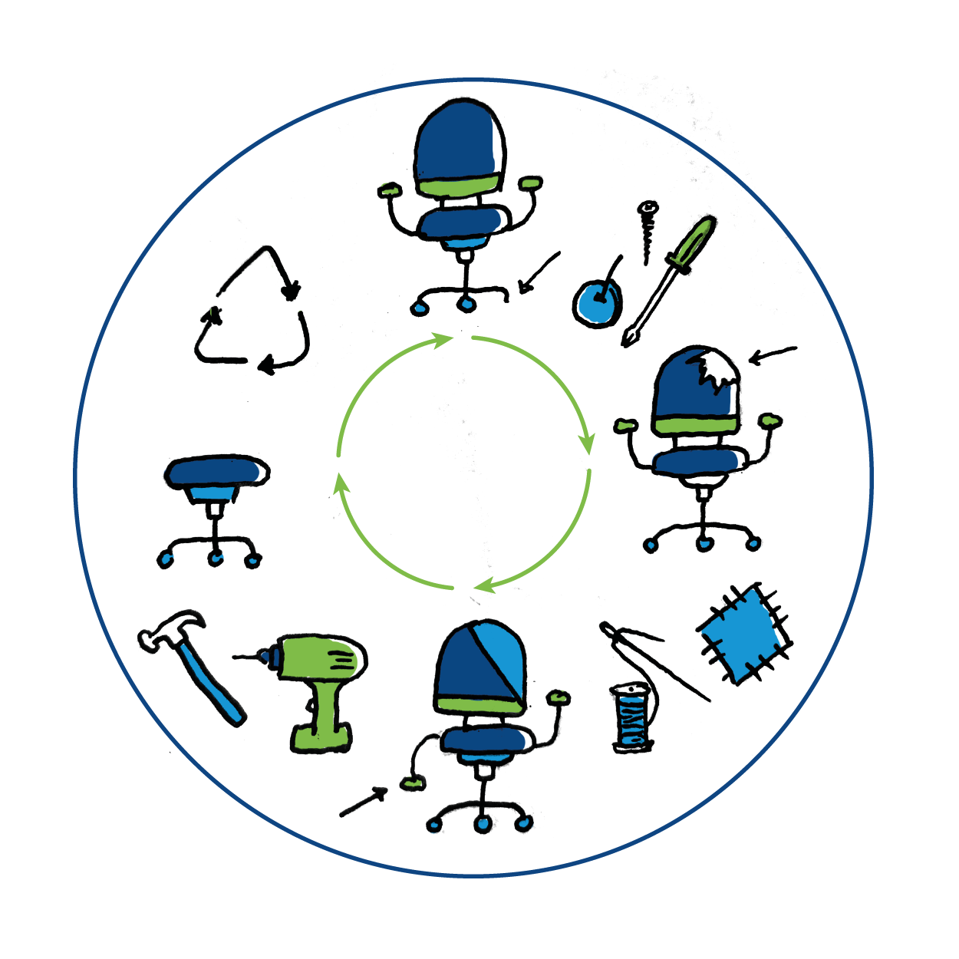





Responsible consumption
A green prescription for a fairer future

Slide 2


What is in the workshop
Overview of SDG 12: Responsible consumption and
SDG 13: Climate action
Starter 1: Story of plastic
Starter 2: Waste timeline
Activity 1: Local actions, global impacts
Activity 2: Consequences wheel
Activity 3: A health emergency
Think, act, reflect

Slide 3

SDG 12:
Responsible consumption
Our existence and survival as a species is defined by using planetary resources. Yet we face daily reminders of the finite nature of many of these resources and the strain human patterns of consumption and production have put on our planet and other species we share it with. In Scotland, the negative impact of the products we buy is often obscured, with production happening in other countries and waste being taken ‘away’. Sustainability in this context means making better, longer use of products and materials so we waste less and consume fewer resources overall.
Notes:
Introduce participants to SDG: 12. More information and the targets can be found here https://www.globalgoals.org/12-responsible-consumption-and-production

Slide 4

SDG 12: Responsible consumption
Think of your average working day. How many of the items you use are single-use and disposed of quickly? Is there a way of making this item re-usable?
If you’ve worked in a low-resource setting, abroad for instance, did you notice differences in how resources were managed?
How do we balance the hygiene needs of effective treatment with targets for sustainable and less wasteful practices?
How does procurement within the NHS support sustainable practices of consumption?
Notes:
These are the ‘big’ questions around SDG: 12 which these activities will stimulate discussion around.

Slide 5
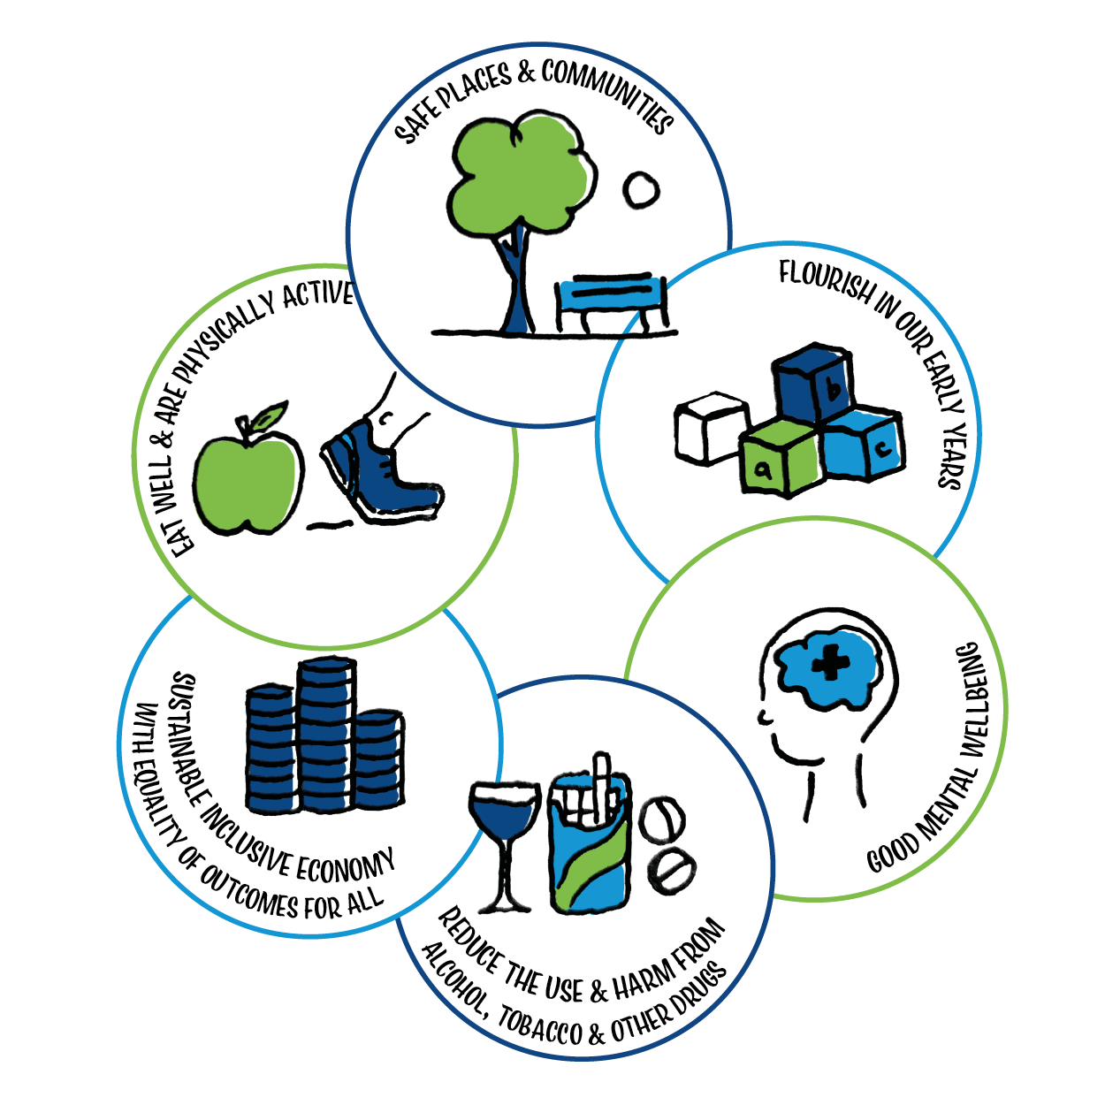
SDG 13: Climate action
Whilst occurring naturally and essential to our survival, greenhouse gases have risen to record levels not seen for 3 million years due to two centuries of industrialisation, deforestation and other human activity.
From shifting weather patterns that threaten food production, to rising sea levels that increase the risk of flooding, the impacts of climate change are global in scope and unprecedented in scale.
Notes:
Introduce participants to SDG: 13. More information and the targets can be found here https://www.globalgoals.org/13-climate-action

Slide 6
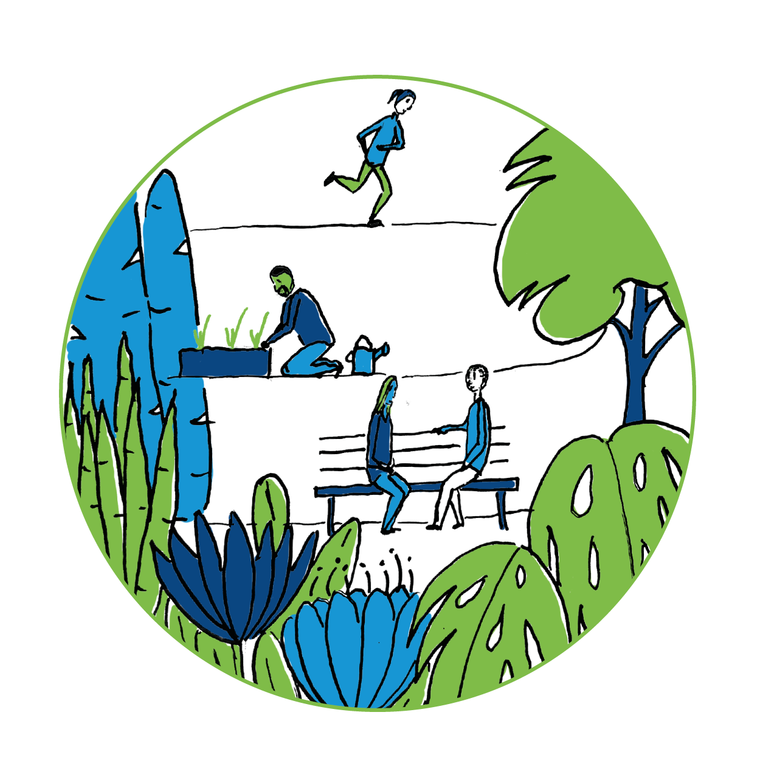

SDG 13: Climate action
Globally, the most serious impacts of climate change are being felt by communities that are already vulnerable and have done the least to cause global warming. Do you think responsibility for climate change is addressed sufficiently?
What does climate change show us about how interconnected we are on a global and individual level?
Climate change has been called a health emergency. How do you respond to that statement?
Notes:
These are the ‘big’ questions around SDG: 13 which these activities will stimulate discussion around.

Slide 7

Starter 1: The story of plastic
Aims
To provide an overview of the causes and consequences of the global plastics crisis
To start thinking about how to end single use plastic
Notes:
Plastic is ubiquitous and widely used within the NHS. While its impact on the environment is starting to get attention this 4 minute films provides an overview of the whole life cycle of plastic that’s hidden from view – one that harms people and the planet from start to finish.

Slide 8
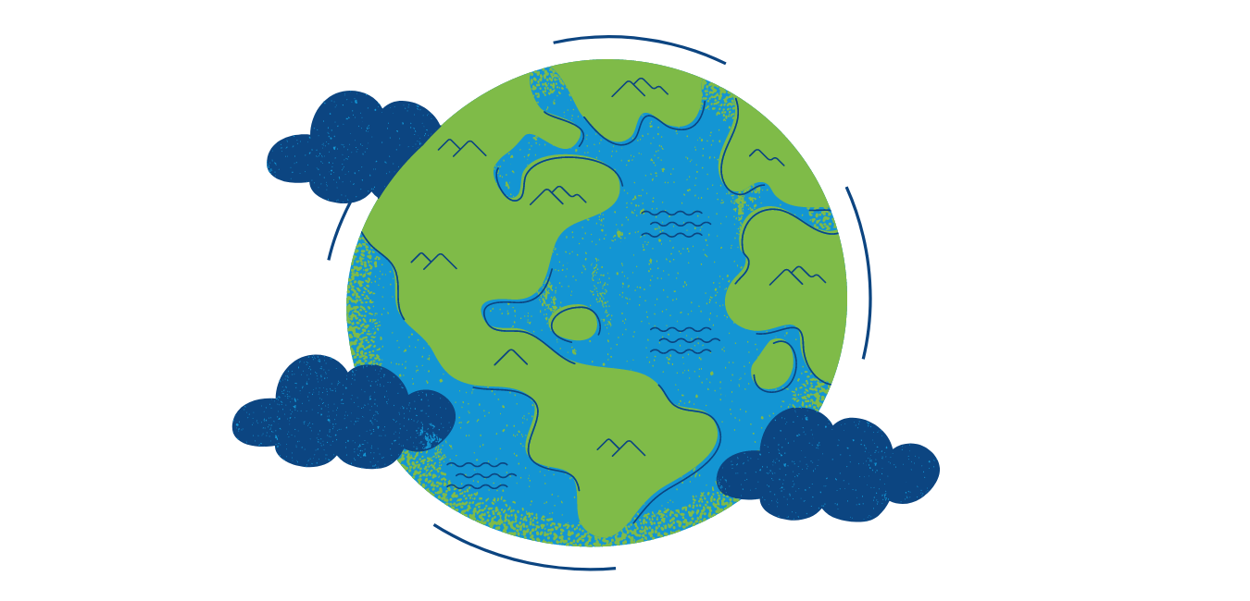

Starter 1: The story of plastic
Watch this 4 minute film from The Story of Stuff
What are your initial responses to the film?
Think about your average working day. How many of the items you use are single-use and disposed of? Are there alternatives?

Slide 9
Starter 2: Waste timeline
Aims
Find out how long it takes for everyday objects to decompose
Review your lifestyle habits

Slide 10
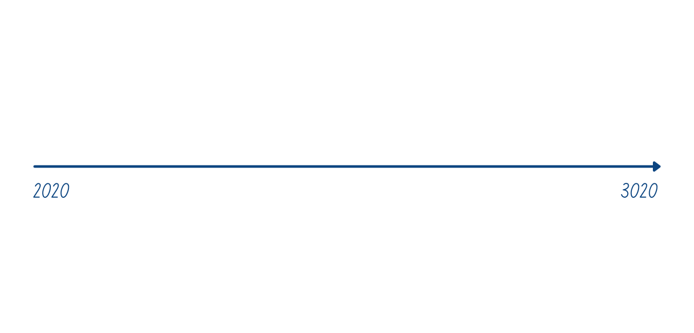





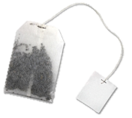


Activity 2: Waste timeline
Notes:
Tell the participants that they are to assume the items have been thrown away in a household bin and therefore decompose at a landfill site.

Slide 11
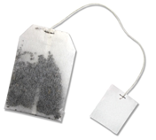
Check your timeline
Did you get them in the right order?
How long do you think it would take each item to decompose on a landfill site?
Notes:
The time items take to decompose will depend on the climate and other environmental conditions in a landfill site.

Slide 12

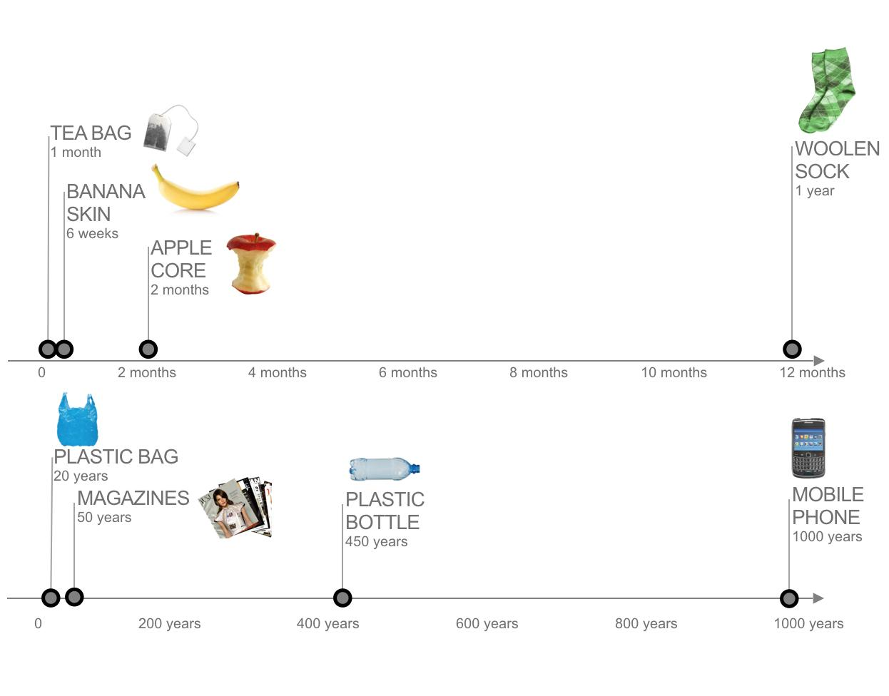
timeline
Notes:
Hold a plenary discussion to explore people’s responses to this activity. Are there any lifestyle choices people might consider taking? The message about plastic bottles and plastic bags is getting out there but how often to people get the ‘latest’ mobile phone when their current one is still fine?
There are many website which give timings for decomposition of different materials. They include https://www.down2earthmaterials.ie/2013/02/14/decompose/

Slide 13
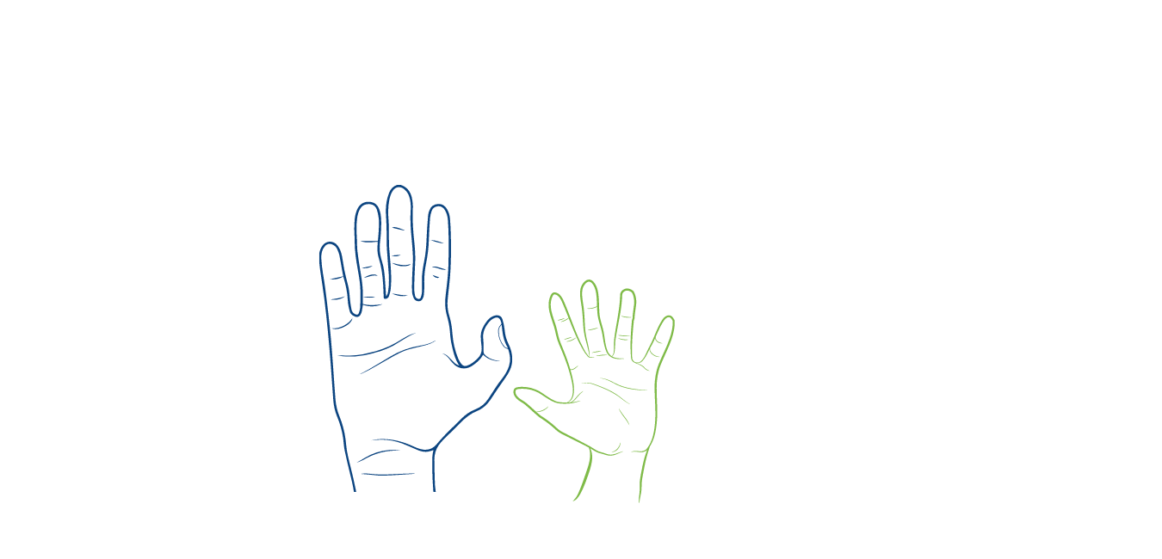
Activity 1: Local actions, global impacts
Aims
To make connections between our local consumption of single use plastic and the global impacts of this use
To recognise that recycling is only a partial solution to the problem of plastic waste
Notes:
The activity explores some of the unintended consequences of our use of plastic and how it can have health repercussions for those in the UK and overseas who are living near plastic waste dumps.

Slide 14

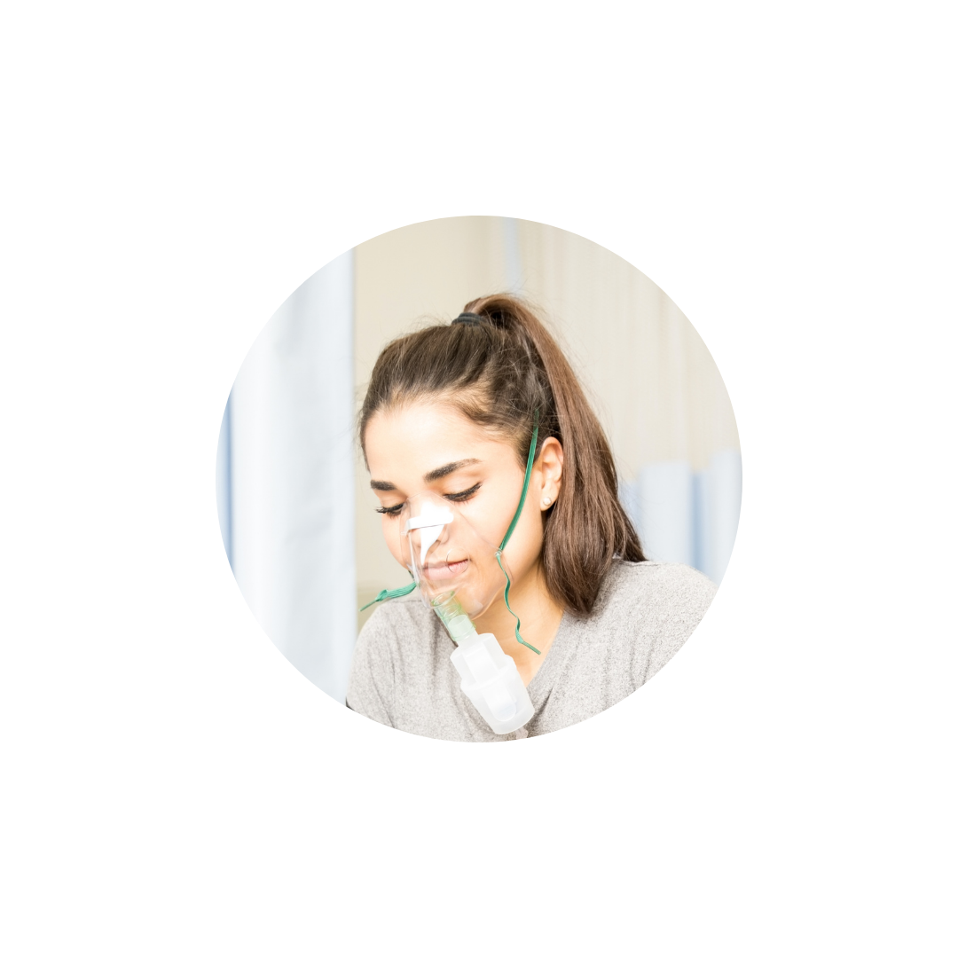
Activity 1: Local actions, global impacts
What connects this disposable plastic cup used in a hospital in Scotland to patients presenting with respiratory problems in Malaysia?
Use the statements on the next slide to solve the mystery and answer the question.

Slide 15
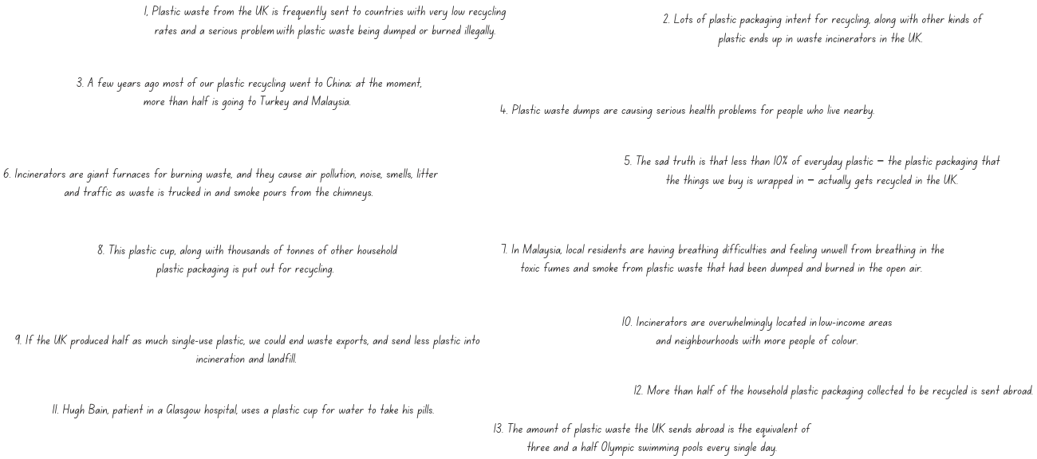
Activity 1: Local actions, global impacts

Slide 16
Activity 1: Local actions, global impact
What surprised you / challenged you in the activity?
Think of your average working day. How many of the items you use are single-use and disposed of quickly? Is there a way of making this item re-usable?
How do we balance the hygiene needs of effective treatment with targets for sustainable and less wasteful practices?
Notes:
Use these discussion questions to debrief the activity – draw out that this is a social justice issue as well as an environmental issue with those affected living in poorer communities both in the UK and overseas.

Slide 17


Activity 2: Consequences wheel
Aims
To identify and map where waste is happening in your work place
To build connections between cause and effect
To identify the global significance of local actions, and the local significance of global issues.

Slide 18
Activity 2: The consequences wheel
Thinking about your professional role. What is an area of waste for your team? (e.g. single use plastic / food waste / carbon footprint / paper)
Choose one area you would like to focus on
Create a consequences wheel using the diagram on the next slide
Notes:
This can be done as a group activity if relevant to the groups needs. Encourage wide thinking about ‘waste’ or ‘over consumption’ depending on the context the participants work in. They will work together to create a consequences wheel – see template on the next slide.

Slide 19
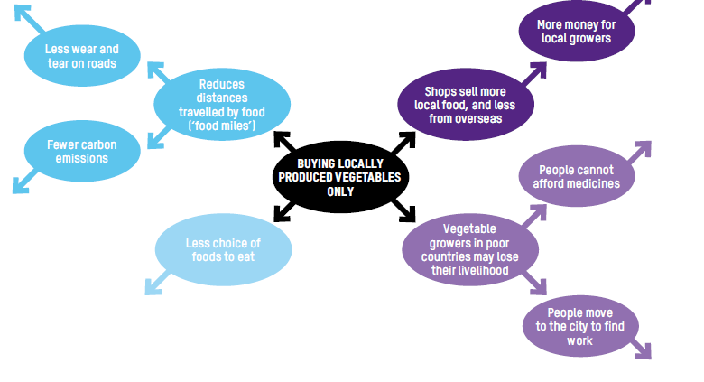
Activity 2: The consequences wheel
Notes:
This shows some of the unintended global consequences of changing behaviour which seems at first a good sustainable step to take. When considering environmental impacts it is important to consider the social impacts too.

Slide 20
Activity 2: The consequences wheel
Were there any unforeseen consequences which your wheel highlighted?
What local activities had global impacts within your consequences wheel?
How does procurement within the NHS support sustainable practices of consumption?
Notes:
If working with groups – ask participants to share their wheels. Hold a plenary discussion using the suggested questions on the slide.

Slide 21
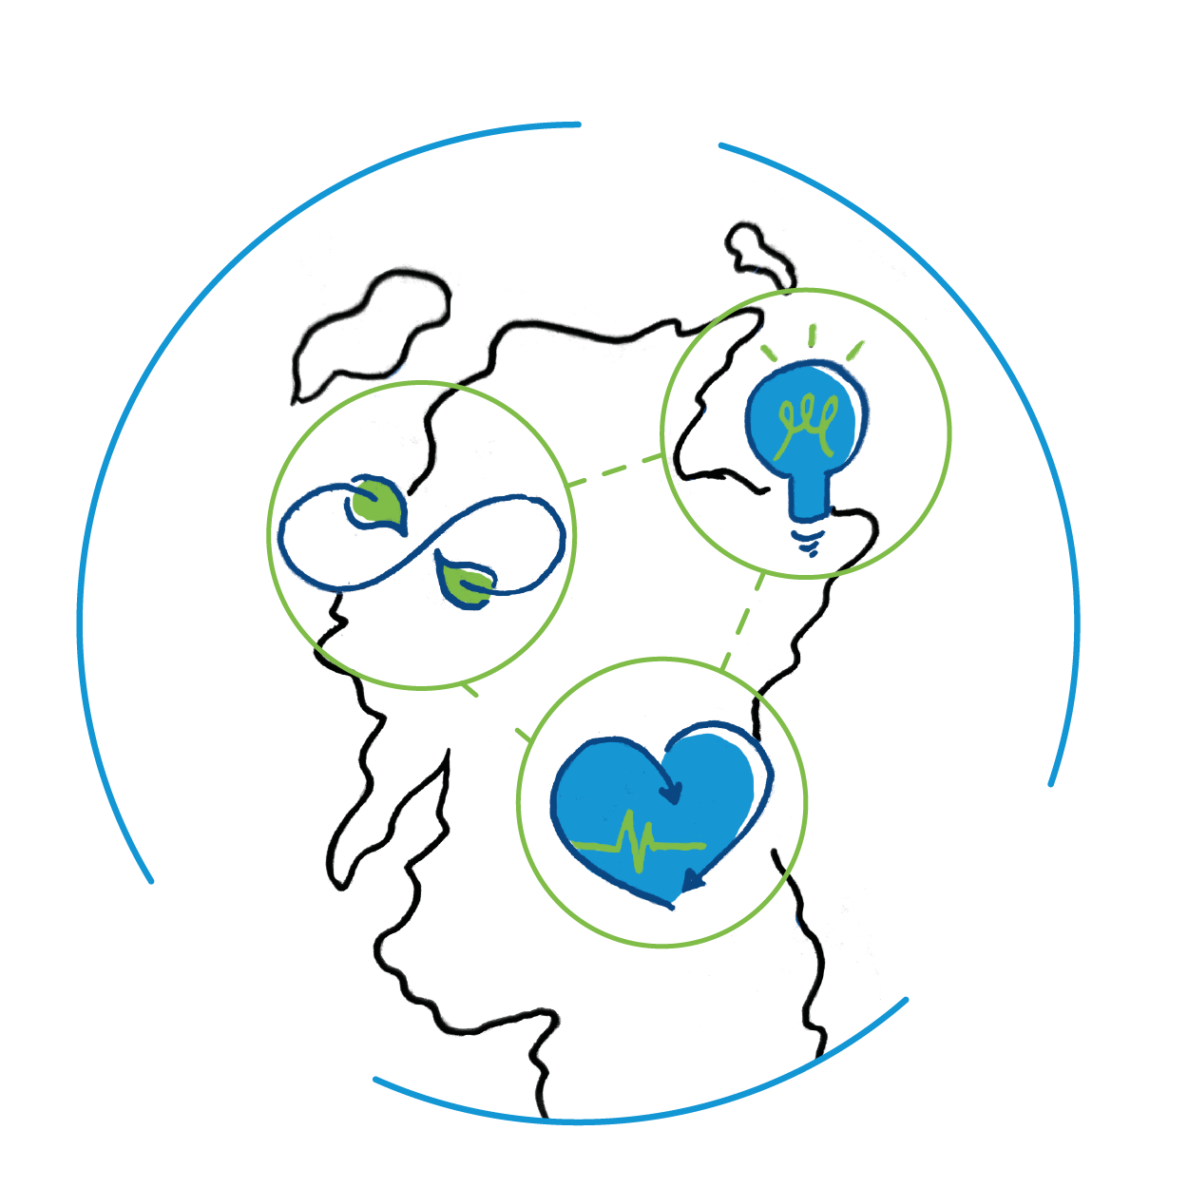
Activity 3: A health emergency
Aims
To examine the impact of climate change on public health locally and globally
To consider the active role NHS Scotland practitioners can play in addressing this

Slide 22


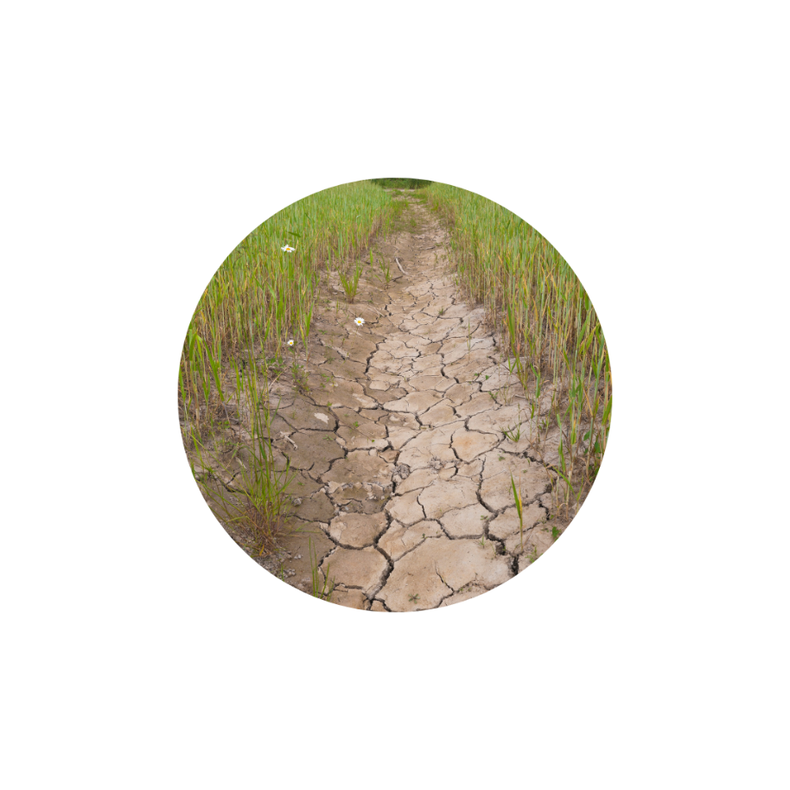
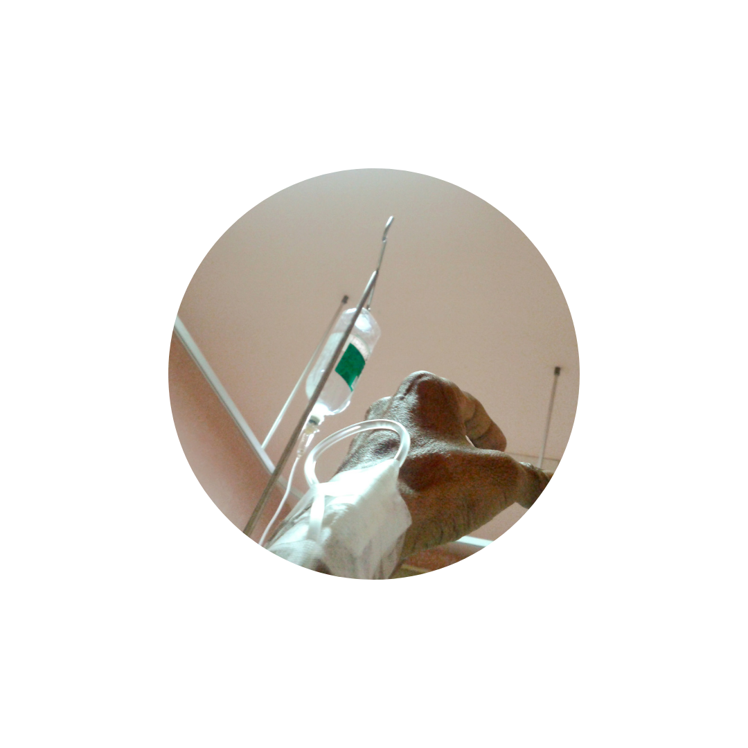


Activity 3: Health inequalities
Air pollution impacts
on respiratory illnesses
Diets high in meat, dairy and soy are bad
for the planet and bad for human health​
Food security is compromised
by flood and drought​​
Water borne disease increases​​​
Secure shelter compromised by flooding and wildfires​​​​
Clean water compromised by flood and drought
Notes:
Locally and globally the changing climate is impacting on people’s health. Usually those in the poorest and most marginalised communities feel these impacts most acutely – within Scotland and around the world.
Share some of the reasons why shown on the slide. Gather more ideas from the participants. Consider if these impact people in the UK and / or globally. Highlight that this is a social justice issue as well as an environmental issue.

Slide 23
Activity 3: A health emergency
Watch this 10 minute clip and listen to David Pencheon – Honorary Professor and an Associate at the Medical and Health School at the University of Exeter – explain why we can not stay silent on this issue.
Notes:
Presentation by David Pencheon – founder Director of the Sustainable Development Unit for NHS England and Public Health England, now an Honorary Professor and an Associate at the Medical and Health School at the University of Exeter, work to understand the role of health professionals and health systems in ensuring a safe, equitable and prosperous planet for all. Watch from 16.25 – 26.55
Hold a plenary discussion to share people’s responses to the presentation.

Slide 24
Activity 3: A health emergency
Globally, the most serious impacts of climate change are being felt by communities that are already vulnerable and have done the least to cause global warming. Do you think responsibility for climate change is addressed sufficiently?
What does climate change show us about how interconnected we are on a global and individual level?
Notes:
Use these reflection questions to broaden out the conversation.
The activities in this workshop lead participants to thinking about actions they can take to reduce waste and mitigate climate change. Slides 9 and 10 in the introductory PPT can help with this. The Think / Reflect / Act section on this workshop will also support this.

Slide 25
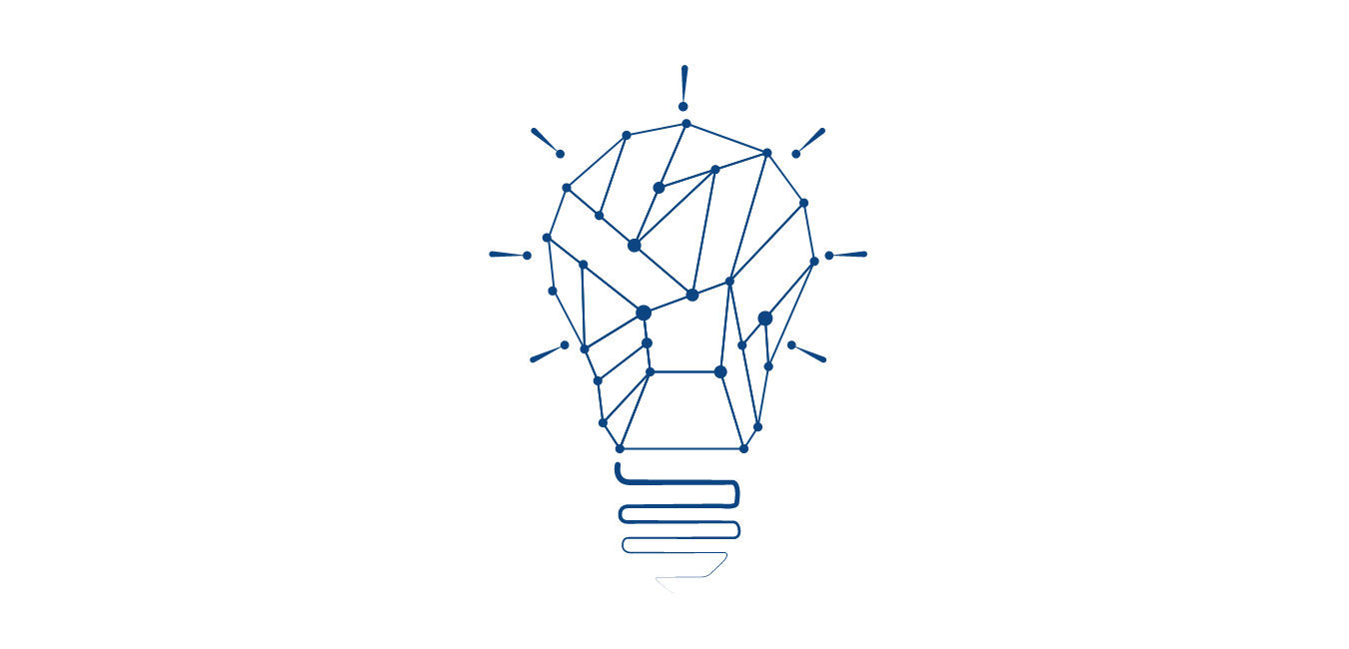


Think
Act
Reflect
Notes:
These following slides can be used flexibly. They provide an opportunity to explore the issues further, to consider what positive actions for change participants can take and reflect on what the group has looked at through out the workshop.

Slide 26


Think - listen
ISSOP May Climate Change Webinar – YouTube
Presentation by Todd Sack, founder mygreendoctor.org – advice and support to adopt sustainability as a core value for your practice (4.46 – 15.25)
Great Ormand Street – reducing single use plastic
Case study from Great Ormand Street hospital on how they reduced use of plastic gloves and saved 21 tonnes of plastic

Slide 27

Think - read
ISSOP – International Society for Social Paediatrics and Child Health has published this declaration responding to the impact of climate change on children
Sustainable and environmentally friendly general practice from the BMA – read the pdf
Our natural health service – read all about this exciting initiative
Sustainability Action – championing sustainability for a healthier NHS Scotland

Slide 28

The Health Literacy place – useful source of health literacy information and resources in Scotland
Think - explore
Building sustainable practice in the USA www.mygreendoctor.org
RCGP Green impact for health toolkit
For a Greener NHS case studies Greener NHS » System progress (england.nhs.uk)
Introducing sustainability to the community responsible for the world's life-changing medical and technical innovations www.mygreenlab.org

Slide 29
Act
Get informed – Engage with articles, blogs, videos and campaigns
Be Political – Write to your local MP or MSP
Educate – Host a workshop, talk or discussion about issues
covered in this workshop with your colleagues
Challenge – Use the reflection questions on the next slide
Notes:
Some ideas to encourage participants to get started. You might also want to (re) visit some of the activities from the introductory workshop which has more action ideas.

Slide 30
Reflect
Have I considered climate change within the context of my work? What is the carbon footprint of by practise / hospital etc?
Do I discuss climate change with my patients?
What tools and / or support do I need to start having this conversations?
Can I approach people in my work place to offer help and share my concerns? How confident do I feel about discussion climate change as a health emergency?
Notes:
This is a personal reflection activity but can also be used in discussion especially around how participants feel about speaking out and framing climate change as a health emergency.

Slide 31
Reflect
Something which made you think
Something you are curious about and what to find out more
Something you will do after this session
Notes:
This is an activity to draw the workshop to an end. The workshop materials can be used flexibly and this reflection activity can be used at the end of a session after using any of these materials.
Ask participants to think and share in pairs the points on the slide. If you want to hear all the voices in the room at the end – ask participants to share one of the points with the group.

Slide 32



Thank you for your time
www.scotdec.org.uk
www.scottishglobalhealth.org
@scotdeclearning
@scottishGHCU
The contents of this document are the sole responsibility of the 15 project partners and can in no way be taken to reflect the views of the European Union.

